Slide 1
Random Forest Classification:

Slide 2
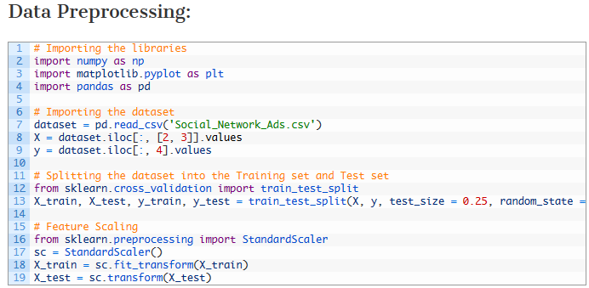

Slide 3
We read “Social_Network_Ads.csv” file and stored in dataset.
Extracted age and salary information from dataset and stored in X
Extracted purchase information from dataset and stored in Y.
Split dataset in training and test set so that machine can be trained using X_train and Y_train
Used feature scaling for X_train.

Slide 4


Slide 5
Imported RandomForestClassifier from sklearn.ensemble
Created a classifier and
provided number of estimators as 10, i.e. our forest will compose of 10 decision trees
applied a widely used ‘entropy’ criterion to it
fitted classifier with training data set

Slide 6
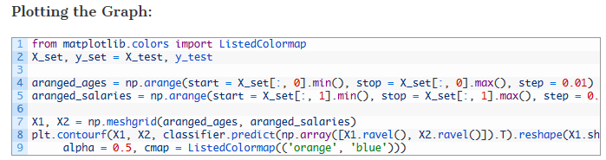

Slide 7
aranged_ages variable will have scaled ages of users starting from minimum age to maximum age incremented by 0.01.
aranged_salaries variable will have scaled salaries of users starting from minimum salary to maximum salary incremented by 0.01.
np.meshgrid() takes aranged_ages and aranged_salaries to form X1 and X2.
X1 and X2 are used for creating a graph which classifies all data points using random forest classification. It is done using plt.contourf(), method.

Slide 8
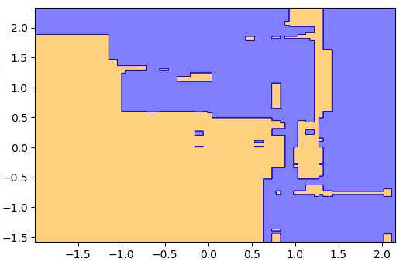

Slide 9
Random forest classification takes number of decision trees as input parameters.
It takes predictions of all decision trees and chooses mostly predicted results from input decision trees.
Mostly predicted results are chosen as final results and they are plotted on graph as above
orange section is of users who will not buy the car and blue section is for users who will buy the car

Slide 10
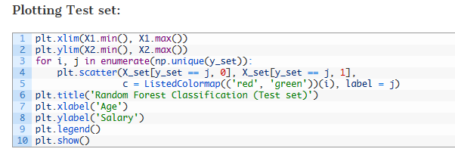

Slide 11
Above code plots actual data points in classification.
Red points denote users who did not buy the car
Green points denote users who bought the car.

Slide 12
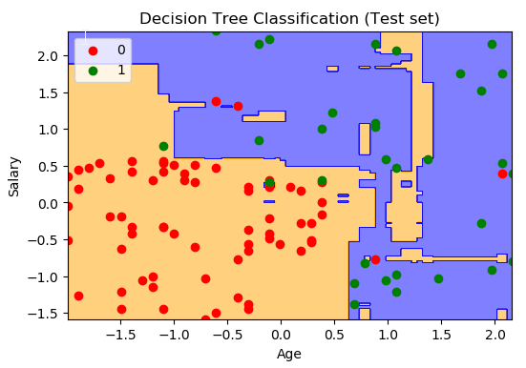

Slide 13
Note that we have plotted 100 observations from our test set and out of them
3 green points are observed on orange area
5 red points are observed in blue area
This means, out of 100 observation points, random forest classification predicted 92 results correctly and only 8 are incorrect.

